Slide 1
Nonlinear Photoresponse of Coupled Monolayers

Slide 2
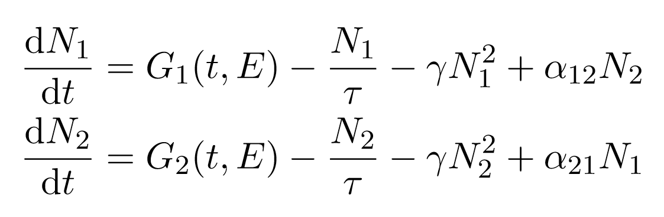
Model
exciton density
directional coupling
photoresponse time
exciton-exciton annihilation
excitation function

Slide 3
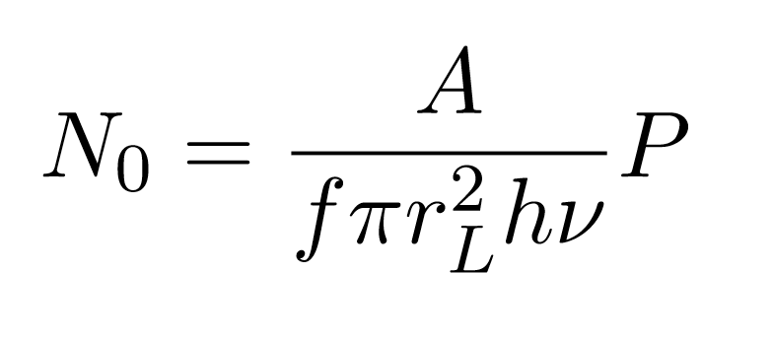
Excitation function
minimal excitation energy = bandgap?
pulse photon energy
initial exciton density
time average power
absorption coefficient
laser radius
laser frequency

Slide 4
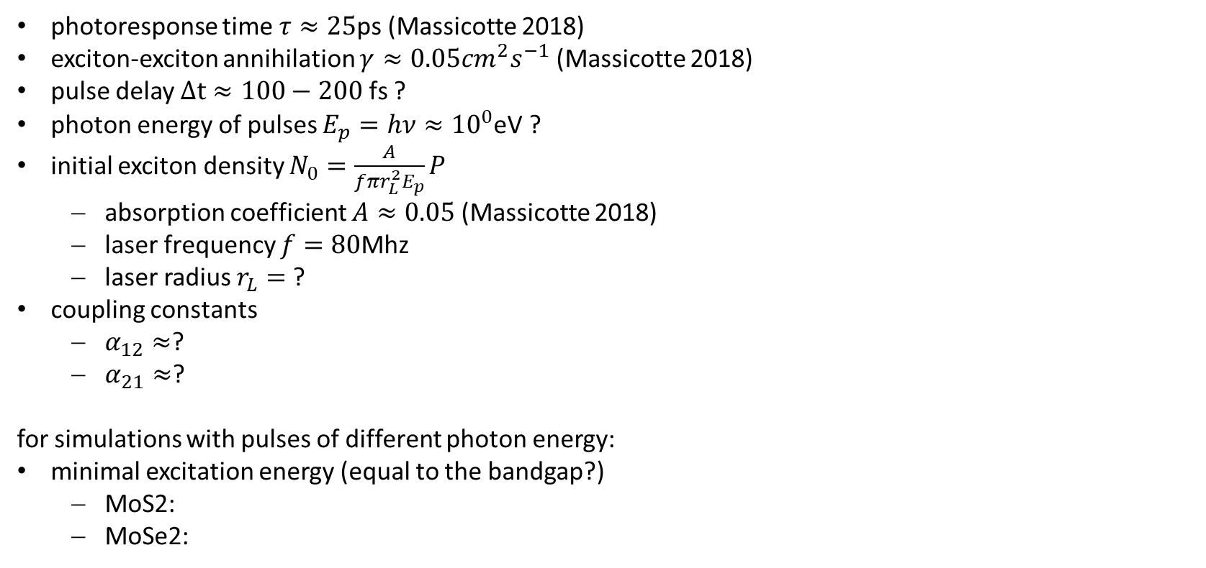
Parameter estimations
photoresponse time $τ≈25$ps (Massicotte 2018)
exciton-exciton annihilation $γ≈0.05cm^{2}s^{−1}$ (Massicotte 2018)
pulse delay $Δt≈100−200$ fs ?
photon energy of pulses $E_{p}=hν≈{10}^{0}$eV ?
initial exciton density $N_{0}=\frac{A}{fπr_{L}^{2}E_{p}}P$
absorption coefficient $A≈0.05$ (Massicotte 2018)
laser frequency $f=80$Mhz
laser radius $r_{L}=$?
coupling constants
$α_{12}≈$?
$α_{21}≈$?
for simulations with pulses of different photon energy:
minimal excitation energy (equal to the bandgap?)
MoS2:
MoSe2:

Slide 5
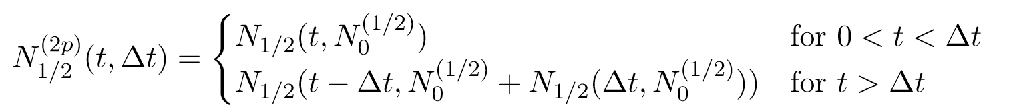
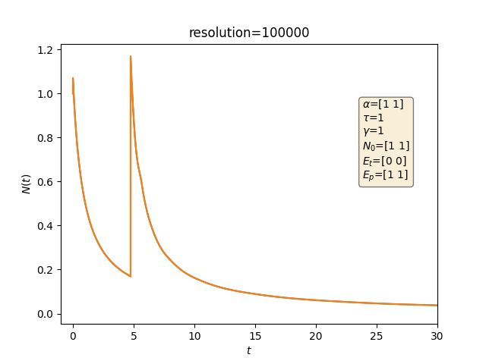
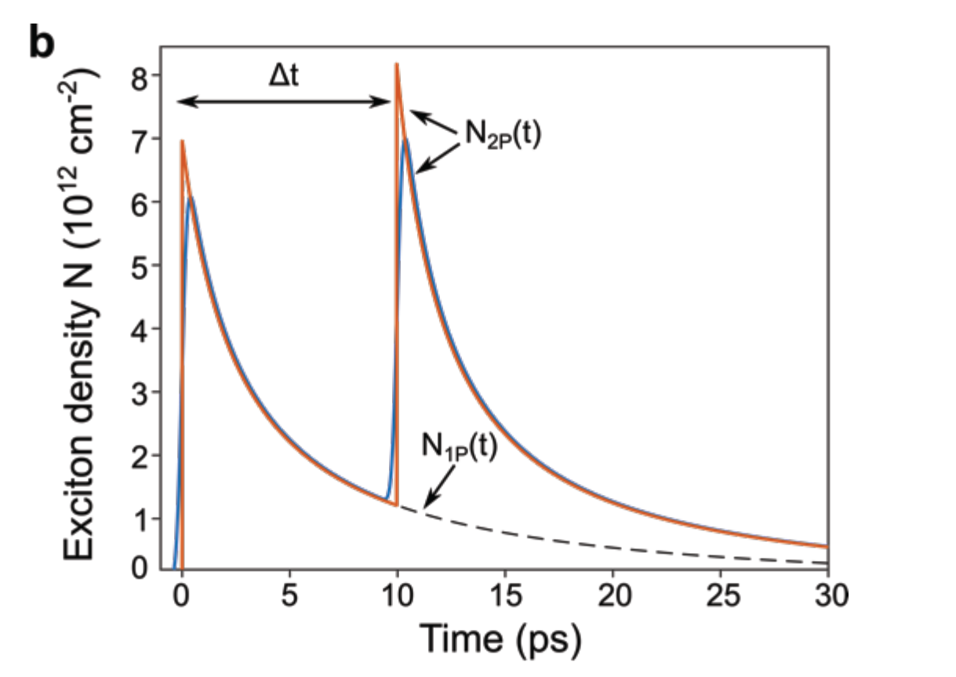
two-pulsed exciton density
Massicotte 2018, Supp. Fig 10b
own simulation

Slide 6
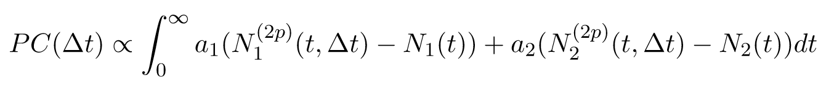
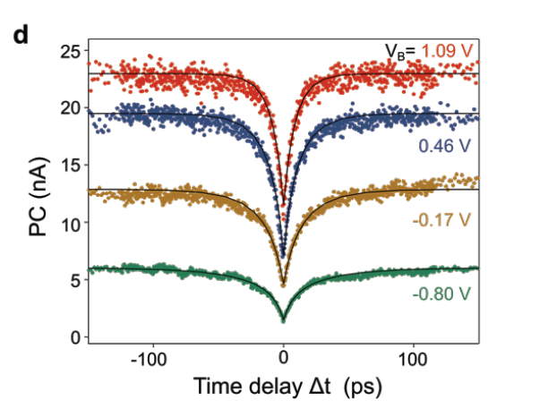
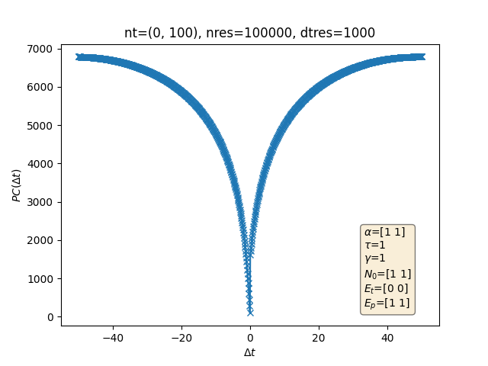
Photocurrent
Massicotte 2018, Supp. Fig 10d
own simulation

